Slide 1



Slide 2

  Transaction is a collection of several operations on the Database appears to be a single unit.
  begin transaction and end transaction
  Since a transaction is indivisible, it either executes in its entirety or not at all.
  Transforms database from one consistent state to another, although consistency may be violated during transaction.

Slide 3

Can have one of two outcomes:
  Success - transaction commits and database reaches a new consistent state.
  Failure - transaction aborts, and database must be restored to consistent state before it started. Such a transaction is rolled back or undone.
Committed transaction cannot be aborted.
Aborted transaction that is rolled back can be restarted later.

Slide 4

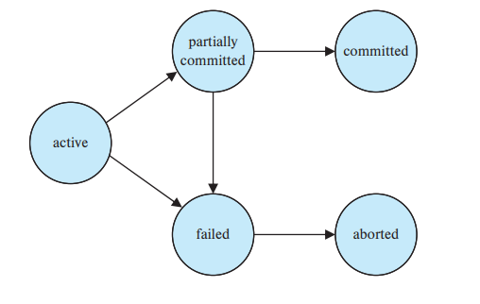
A transaction has committed only if it has entered the committed state. Similarly, we say that a transaction has aborted only if it has entered the aborted state. A transaction is said to have terminated if it has either committed or aborted.

Slide 5

A transaction starts in the active state. When it finishes its final statement, it enters the partially committed state.
At this point, the transaction has completed its execution, but it is still possible that it may have to be aborted, since the actual output may still be temporarily residing in main memory, and thus a hardware failure may preclude its successful completion.
The database system then writes out enough information to disk that, even in the event of a failure, the updates performed by the transaction can be re-created when the system restarts after the failure. When the last of this information is written out, the transaction enters the committed state.

Slide 6
A transaction enters the failed state after the system determines that the transaction can no longer proceed with its normal execution (e.g., because of hardware or logical errors). Such a transaction must be rolled back. Then, it enters the aborted state. At this point, the system has two options:
  It can restart the transaction, but only if the transaction was aborted as a result of some hardware or software error that was not created through the internal logic of the transaction. A restarted transaction is considered to be a new transaction.
  It can kill the transaction. It usually does so because of some internal logical error that can be corrected only by rewriting the application program, or because the input was bad, or because the desired data were not found in the database.

Slide 7

Multiple transactions are allowed to run concurrently in the system. Advantages are:
  increased processor and disk utilization, leading to better transaction throughput: one transaction can be using the CPU while another is reading from or writing to the disk
  reduced waiting time for transactions: short transactions need not wait behind long ones.

Slide 8

Process of managing simultaneous operations on the database without having them interfere with one another.
Prevents interference when two or more users are accessing database simultaneously and at least one is updating data.
Although two transactions may be correct in themselves, interleaving of operations may produce an incorrect result.

Slide 9

Three examples of potential problems caused by concurrency:
  Lost update problem.
  Uncommitted dependency problem.
  Inconsistent analysis problem.

Slide 10

Successfully completed update is overridden by another user.
T₁ withdrawing £10 from an account with bal_{x}, initially £100.
T₂ depositing £100 into same account.
Serially, final balance would be £190.

Slide 11

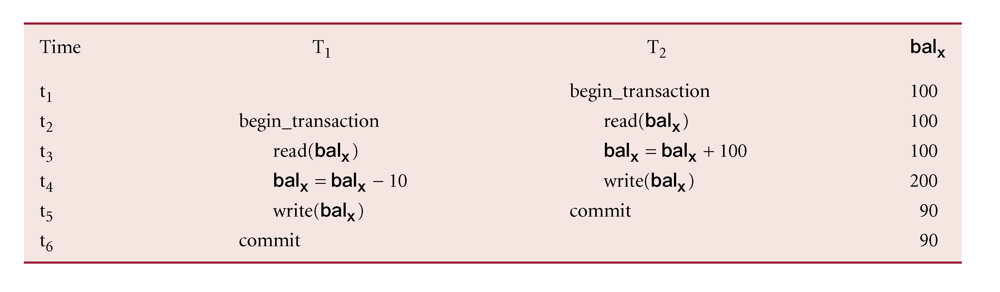

Slide 12

Occurs when one transaction can see intermediate results of another transaction before it has committed.
T₄ updates bal_{x} to £200 but it aborts, so bal_{x} should be back at original value of £100.
T₃ has read new value of bal_{x} (£200) and uses value as basis of £10 reduction, giving a new balance of £190, instead of £90.

Slide 13

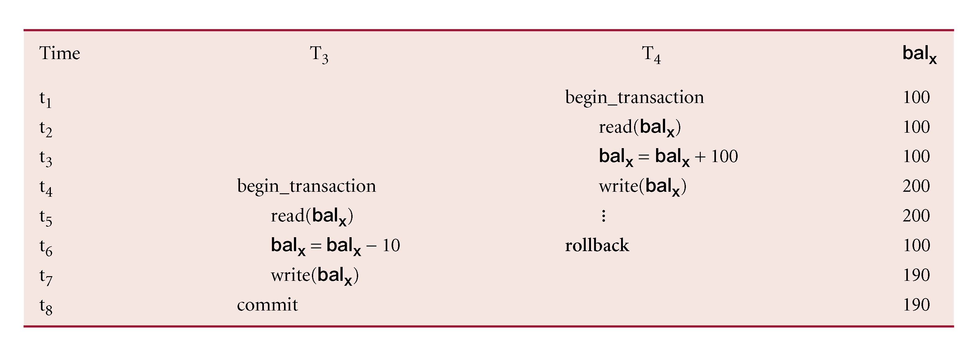

Slide 14

Occurs when transaction reads several values but second transaction updates some of them during execution of first.
Sometimes referred to as dirty read or unrepeatable read.
T₆ is totaling balances of account x (£100), account y (£50), and account z (£25).
Meantime, T₅ has transferred £10 from bal_{x} to bal_{z}, so T₆ now has wrong result (£10 too high).

Slide 15

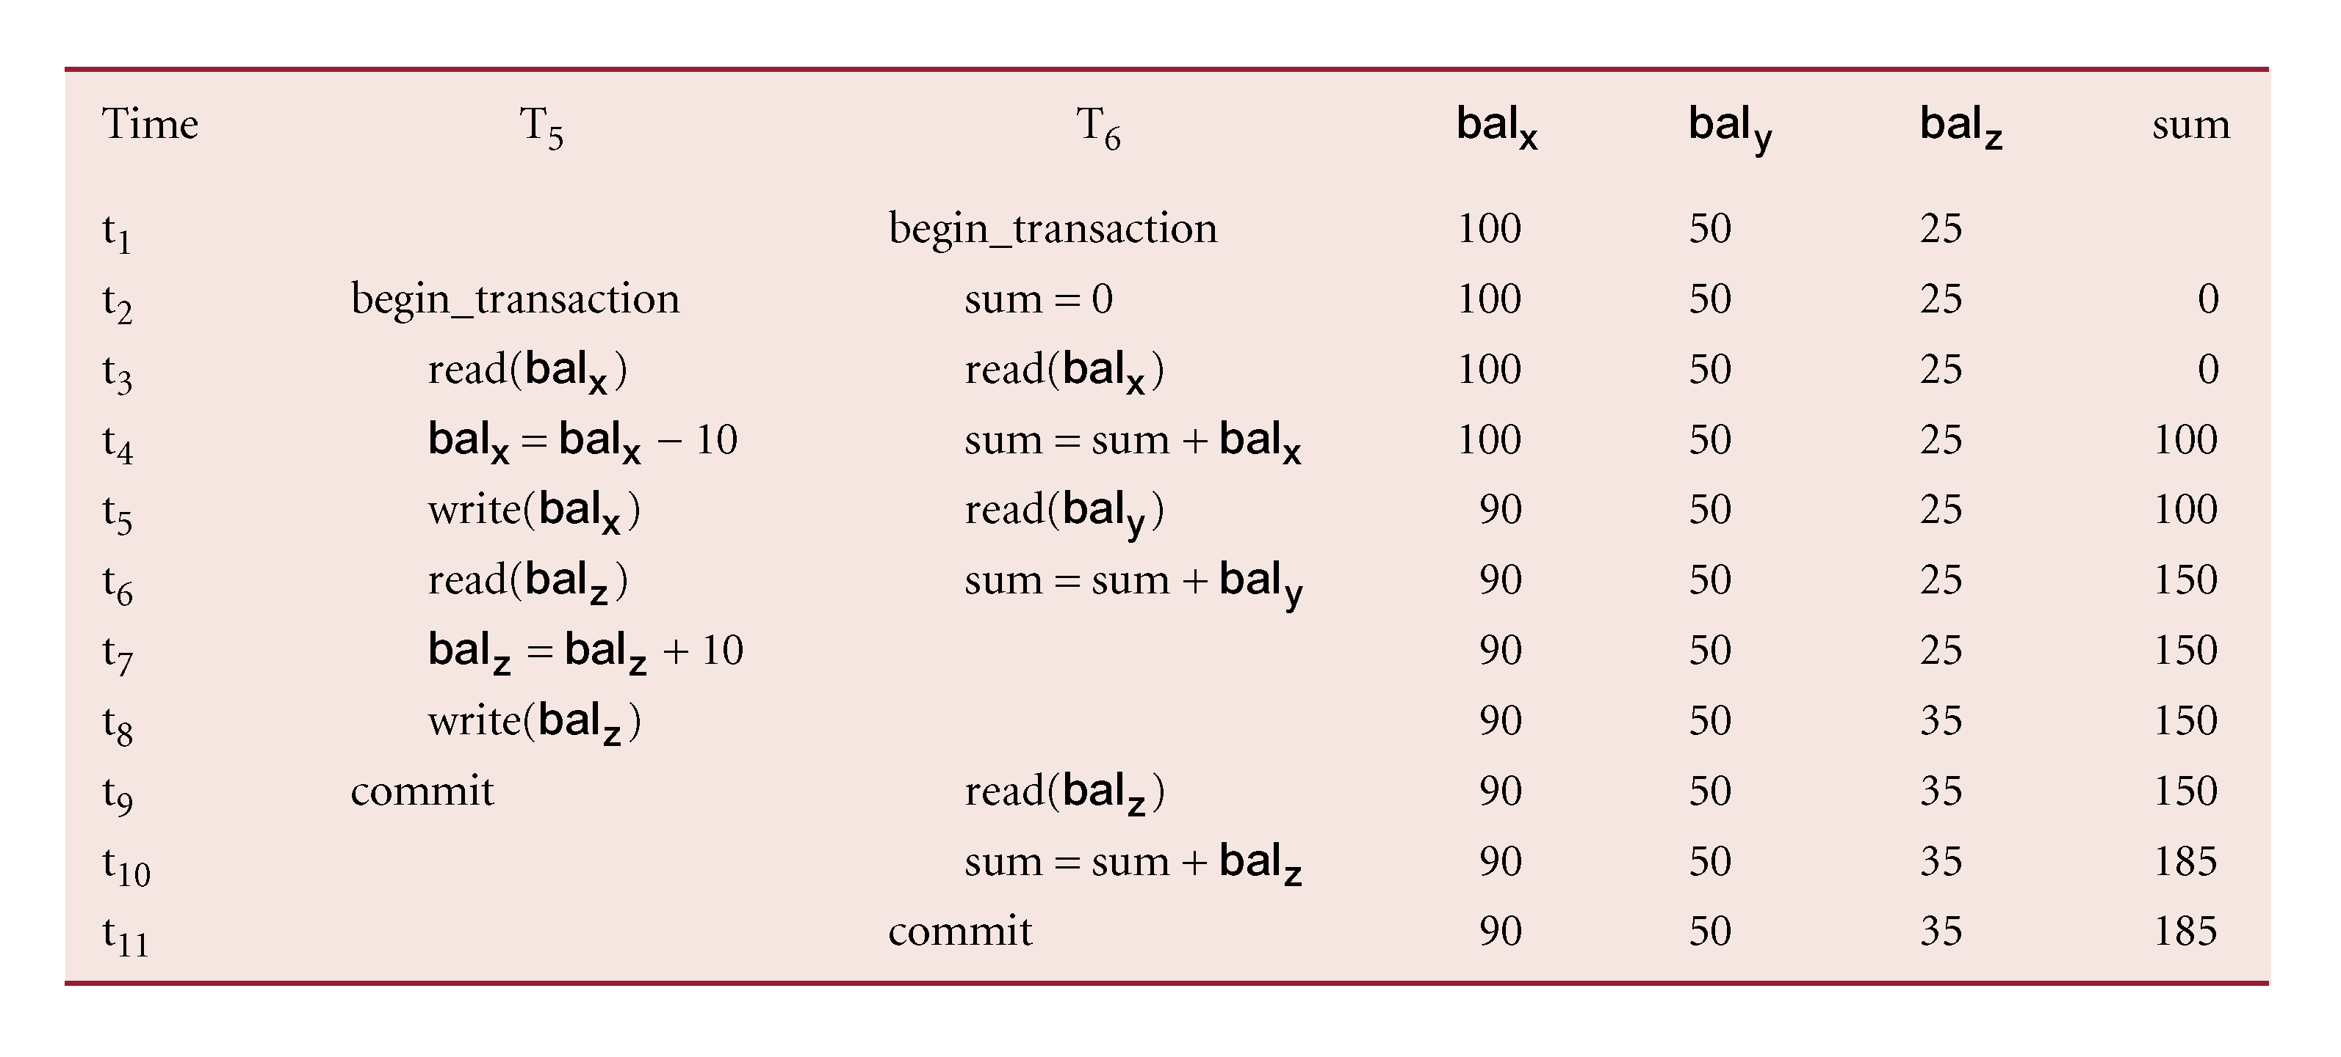

Slide 16

Schedules – sequences that indicate the chronological order in which instructions of concurrent transactions are executed
  a schedule for a set of transactions must consist of all instructions of those transactions
  must preserve the order in which the instructions appear in each individual transaction.

Slide 17

Sequence of reads/writes by set of concurrent transactions.
There are 2 types of scheduling-
Serial scheduling
Non serial scheduling

Slide 18

T1 | T2
READ(A) | READ(A)
A := A-100 | A:= A*1.10
WRITE(A) | WRITE(A)
READ(B) | READ(B)
B:= B+100 | B:= B*1.10
WRITE(B) | WRITE(B)

Slide 19

Definition: A schedule of transactions is serial if its transactions occur consecutively, one after another.

Slide 20

T1 | T2
READ(A)
A := A-100
WRITE(A)
READ(B)
B := B+100
WRITE(B)
 | READ(A)
 | A := A*1.10
 | WRITE(A)
 | READ(B)
 | B := B*1.10
 | WRITE(B)

Slide 21

Schedule where operations from set of concurrent transactions are interleaved.

Slide 22

T1 | T2
READ(A)
A := A-100
WRITE(A)
 | READ(A)
 | A := A*1.10
 | WRITE(A)
READ(B)
B:= B+100
WRITE(B)
 | READ(B)
 | B := B*1.10
 | WRITE(B)
Notice: this is NOT a serial schedule

Slide 23

T1 | T2
READ(A)
A := A-100
WRITE(A)
 | READ(A)
 | A := A*1.10
 | WRITE(A)
 | READ(B)
 | B := B*1.10
 | WRITE(B)
READ(B)
B:= B+100
WRITE(B)

Slide 24

We want to allow interleaved schedules like S2&S3, otherwise the DBMS becomes a (very slow) batch system.
S2 Looks good. Why?
Any DBMS should allow S2.
What is wrong with S3?
Any DBMS should forbid S3.
How can we distinguish between S2 and S3?

Slide 25

Definition: A schedule is serializable if its effect on the DB is the same as the effect of some serial schedule.
  Clearly serial schedules like S1 are serializable
  S2 is serializable
  S3 is not serializable.
The goal of the concurrency control subsystem of a DBMS is to ensure serializability*
First we will study the theory of serializability, then we will see how it is ensured in practice.

Slide 26

Objective of a concurrency control protocol is to schedule transactions in such a way as to avoid any interference.
Could run transactions serially, but this limits degree of concurrency or parallelism in system.
Serializability identifies those executions of transactions guaranteed to ensure consistency.

Slide 27

Objective of serializability is to find nonserial schedules that allow transactions to execute concurrently without interfering with one another.
In other words, want to find nonserial schedules that are equivalent to some serial schedule. Such a schedule is called serializable.

Slide 28

In serializability, ordering of read/writes is important:
If two transactions only read a data item, they do not conflict and order is not important.
If two transactions either read or write completely separate data items, they do not conflict and order is not important.
If one transaction writes a data item and another reads or writes same data item, order of execution is important.

Slide 29

Used to test for serializability
Create
  node for each transaction;
  a directed edge T_{i} → T_{j} ,
  Ti executes write(Q) before Tj executes read(Q).
  Ti executes read(Q) before Tj executes write(Q).
  Ti executes write(Q) before Tj executes write(Q).
  If precedence graph contains cycle Then the schedule is not serializable.

Slide 30
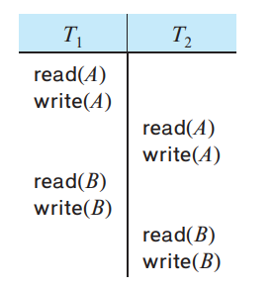


Slide 31
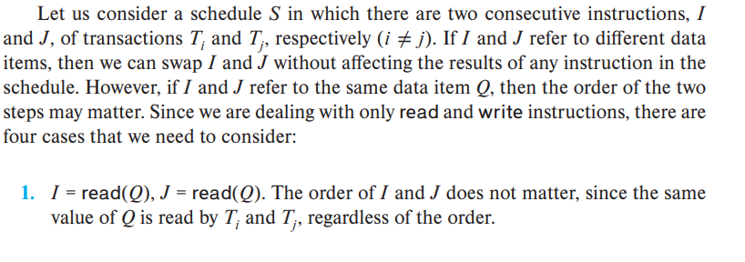
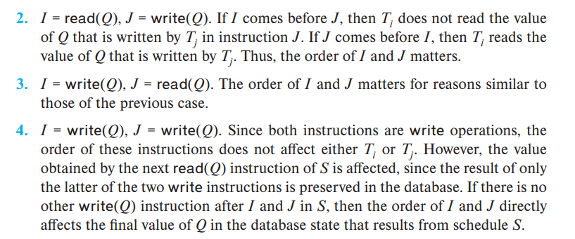

Slide 32
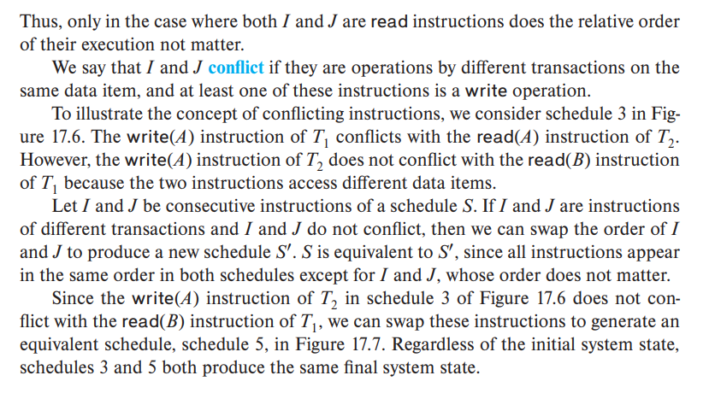
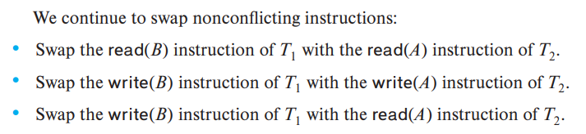

Slide 33

T1 | T2
READ(A)
A := A-100
WRITE(A)
READ(B)
B := B+100
WRITE(B)
 | READ(A)
 | A := A*1.10
 | WRITE(A)
 | READ(B)
 | B := B*1.10
 | WRITE(B)
T1
T2

Slide 34
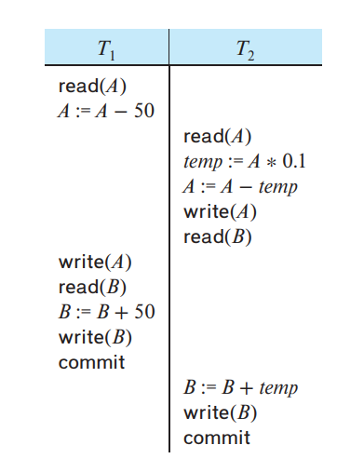

Slide 35

T1 | T2
READ(A)
A := A-100
WRITE(A)
 | READ(A)
 | A := A*1.10
 | WRITE(A)
READ(B)
B:= B+100
WRITE(B)
 | READ(B)
 | B := B*1.10
 | WRITE(B)
T1
T2

Slide 36

T1 | T2
READ(A)
A := A-100
WRITE(A)
 | READ(A)
 | A := A*1.10
 | WRITE(A)
 | READ(B)
 | B := B*1.10
 | WRITE(B)
READ(B)
B:= B+100
WRITE(B)
T1
T2

